Slide 1


Data Visualization of Google Play Store Data
Presented by,
Sandeep Kumar Yedla
Bhavani Maddala
Shanmukh Alluri

Slide 2
Introduction
Android is the dominant mobile operating system today with about 85% of all mobile devices running Google’s OS.
The Google Play Store is the largest and most popular Android app store.
The purpose of our project is to gather, analyze and visualize detailed information on apps in the Google Play Store in order to provide insights on app features and the current state of the Android app market.
With this project we will take you through a journey of analysing various apps found on the play store with the help of different R libraries.

Slide 3
Dataset & Cleaning
The dataset has been taken from Kaggle and it consists of 13 columns – App, Category, Rating, Reviews, Size, Installs, Type, Price, Content Rating, Genres, Last Updates, Current Ver and Android 10841 Rows.
We used Excel, Python and R for cleaning the data.
The columns in the dataset that were cleaned Size , Installs, Data and N/A values.
Using Excel, the ‘+’ sign in the installs was removed.
Using Python, Size of the applications was modified into KB.
Using R, date and N/A were modified and omitted.

Slide 4
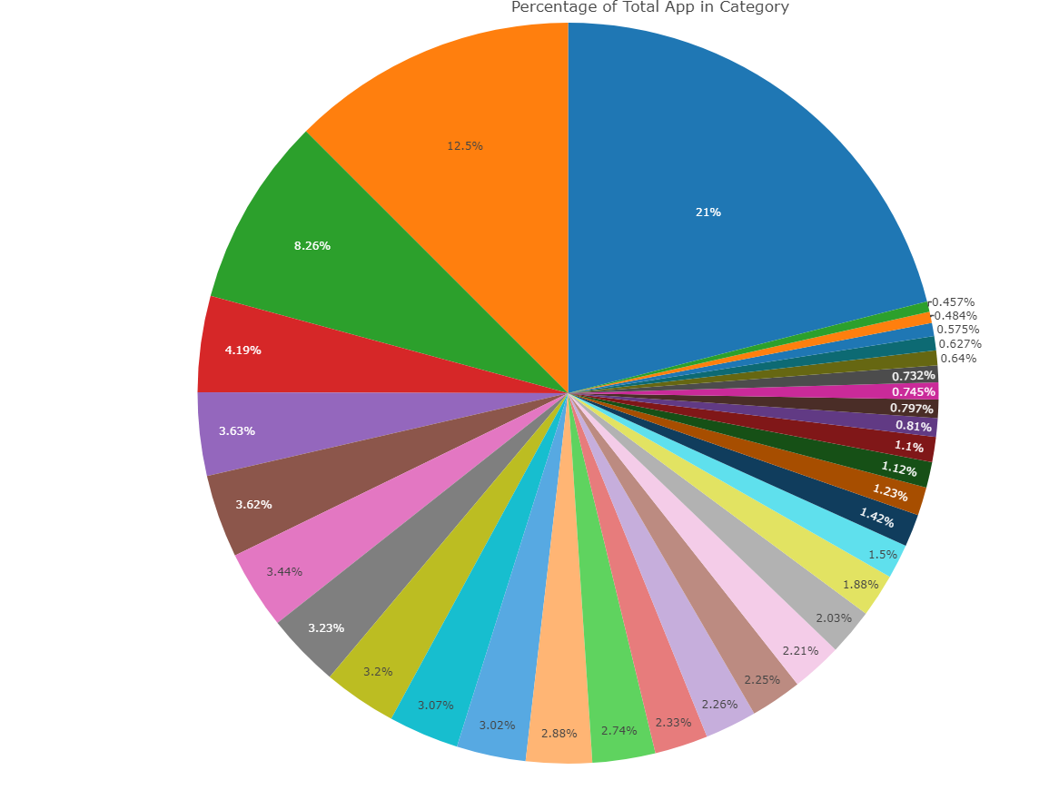
What are the different categories of applications in the play store ?
The google app store data consists of applications under different category
Let us see the total number of applications in each category and understand which constitute to most of the data.
From the Pie chart, we can see that most of the applications fall under the category of Family and least fall under Events and Beauty.

Slide 5
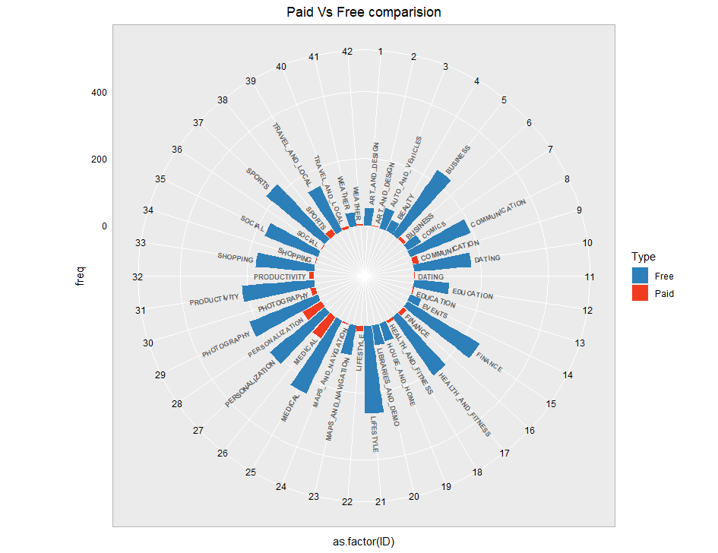
Paid Vs Free Applications in various Categories Using Circular Bar Plot:
The Google play store consists of applications which are both paid and free.
The circular bar graph gives the comparison between free and paid applications.
We can see that most of the applications are free.
Paid applications are mostly under the category of ”Medical” and “Personality”.

Slide 6
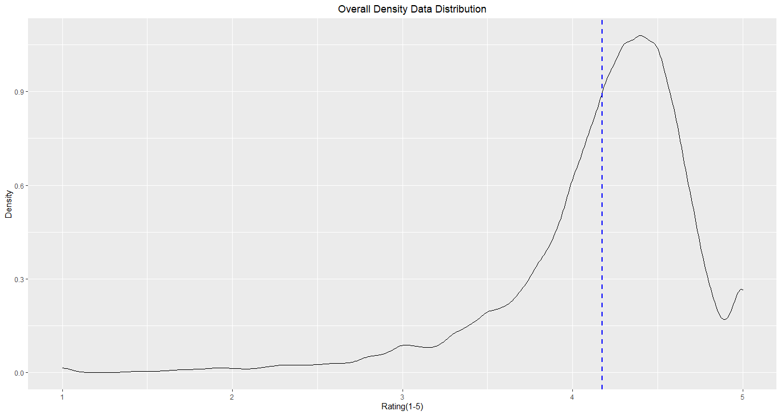
Distribution of ratings of the Applications in the Google Play store Data set using Density Curve:
The analysis of the application ratings in the google play store plays a major role while depicting the current state of the App Market.
A density curve gives the distribution of ratings in the Play store.
From the above graph, we can depict that most of the apps in the google play store are rated between 3.5 to 4.8 and the mean value of the ratings is 4.2.

Slide 7
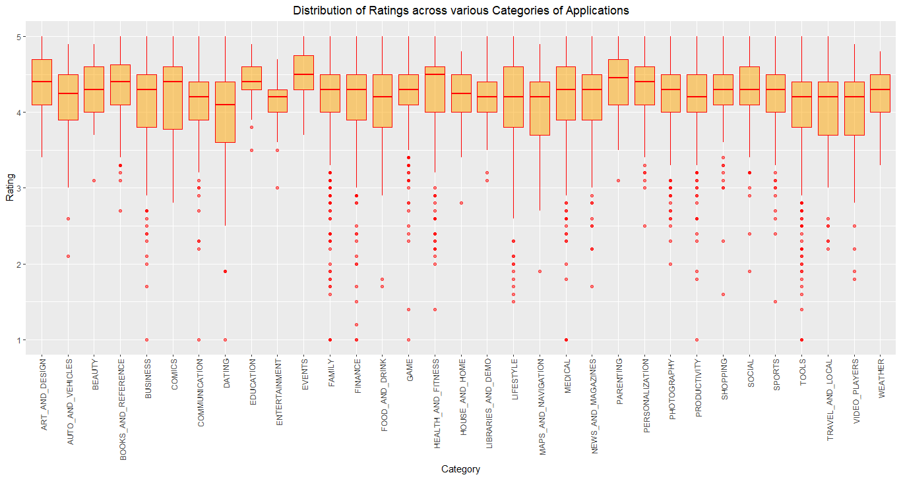
Distribution of Ratings across various Categories of Applications using Side -by- Side Box Plot:
The side-by-side box plot showcases the range of ratings of applications which are under a particular category.
From the plot above, we can conclude that most ratings are continuous, and values are around 3.9 to 4.6.
The outliers are for Family and Tools, because there are more number of installs for the family category and the ratings are distributed right from 1 to 4.5.

Slide 8
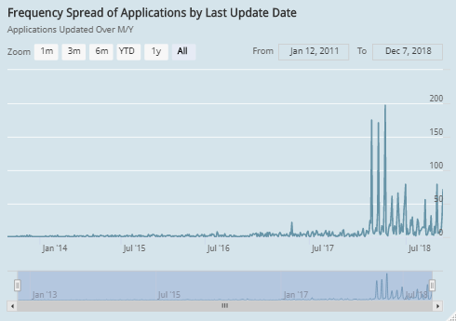
The Applications Updated by the date of last Update:
High chart here gives number of applications updated over the years.
Between the year 2013 to 2017 there are not many applications which have been updated and from 2017 to 2018, we can observe slight increase in the number of applications updated.

Slide 9
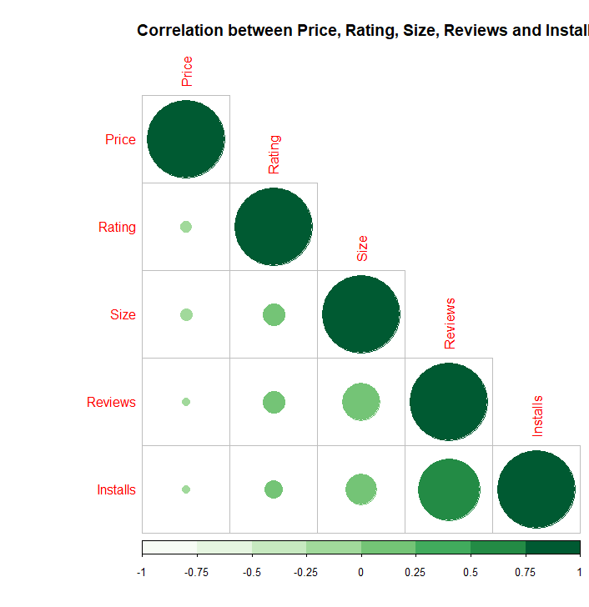
Exploring the relationship between the numerical data using Correlation Plot:
Installs – Price : Negatively correlated
Installs - Rating : Negatively correlated
Installs – Size : No correlation
Installs - Reviews : Positive Correlation.

Slide 10
Conclusion
Based on our Analysis, we can conclude that the category “Family” has highest number of applications
Google play store has more free applications than the paid applications
Paid applications are mostly in medical and personalization category.
The distribution of ratings over the Google Play store is between 3.5 to 4.8
The mean value of the ratings is 4.2.
Family, Tools have more number of outliers.
The ratings are consistent for category Art_and_Design.
The correlation between the application features is not strong enough and is mostly negative or negligible.
Thank you

Slide 11
References
https://www.rdocumentation.org/packages/janitor/versions/2.1.0
https://www.r-graph-gallery.com/piechart-ggplot2.html
https://www.r-graph-gallery.com/circular-barplot.html
https://www.statmethods.net/stats/regression.html
https://www.highcharts.com/blog/tutorials/highcharts-for-r-users/

